Slide 1
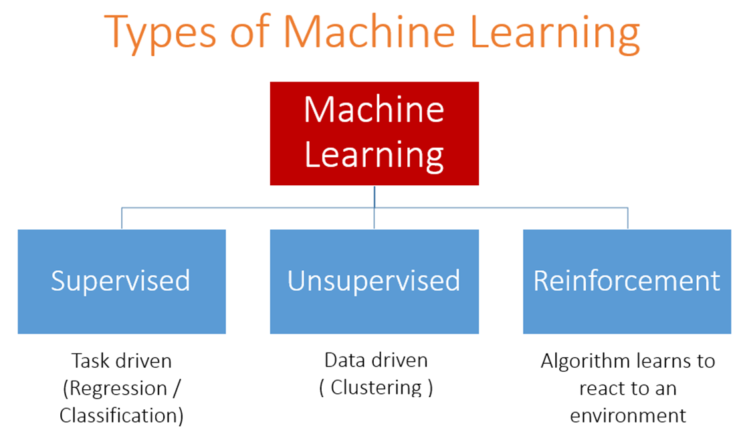

Slide 2
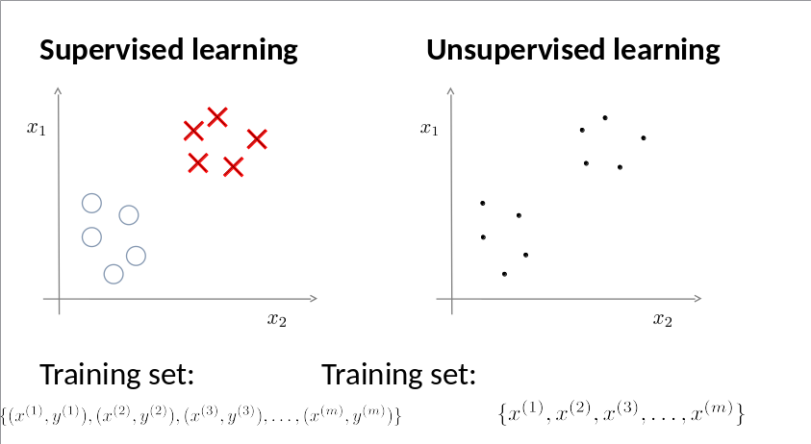

Slide 3
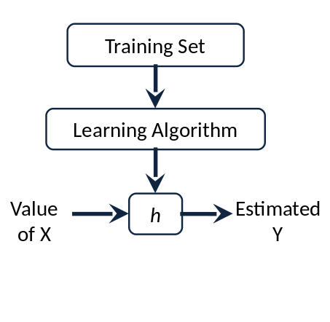
Linear Regression with one Variable
Ulviyya Jafarli
Data Scientist, Sapienza University of Rome
G&I Academy and Business Group

Slide 4

Usage of Linear Regression
Price of the house
Price of the car
Score of the exam
Salary of employees
Weight loss by diet
Yearly Profit

Slide 5
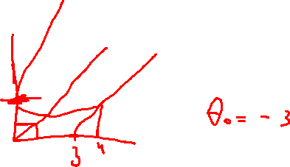

Simple Linear Regression
Coefficient
Independent Variable
Y = b0 + b1 * x
Dependent Variable

Slide 6
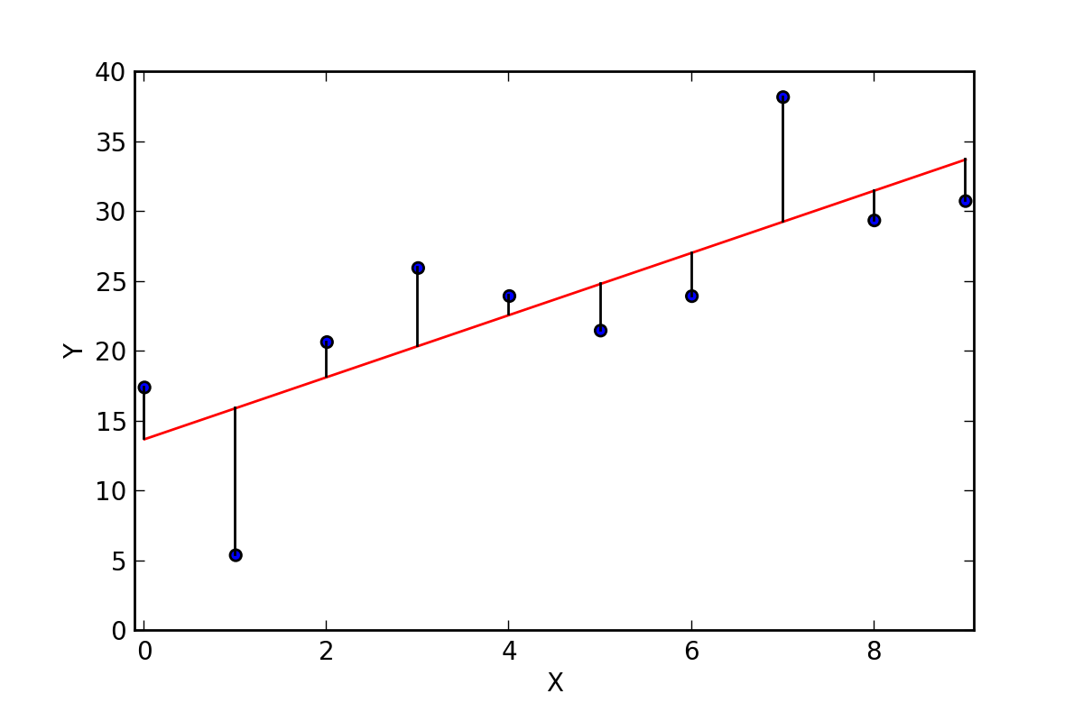
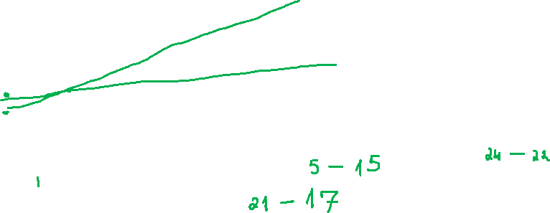
Least Squares
How much it cost(actual) - Yi
ŶŶŶŶŶŶŶ
How much it may cost(predicted) - Ŷi

Slide 7

Least Squares
Sum(Yi - Ŷi)^2 -> min

